Slide 1


K.RAMAKRISHNAN COLLEGE OF TECHNOLOGY
(AUTONOMOUS), TRICHY.
PASSWORD GENERATOR
PRESENTED
Devipriya.P
2303811710422024
SUPERVISOR
Mr. M. Saravanan, M.E.,
AP/CSE.

Slide 2
PRESENTATION OVERVIEW
Objective
Project Introduction
Problem Statement
Methodologies (Programming concepts relevant to problem statement)
Architecture of the proposed system
List of Modules
MResults erits
and Discussion
Queries

Slide 3
OBJECTIVE
The objective for your "password generator" project in Java could be to create a secure and customizable tool that can generate strong and random passwords for users.
This project aims to enhance cybersecurity by providing users with a tool to generate unique and complex passwords that are difficult to crack, thus improving the security of their online accounts and sensitive information.

Slide 4
PROJECT INTRODUCTION
The Password Generator project aims to simplify this process by providing a reliable and user-friendly tool for creating strong, random passwords.
Built using Java, the application allows users to specify the desired length and customize the inclusion of special characters.
By ensuring a mix of uppercase letters, lowercase letters, digits, and optional special symbols, the generated passwords are both secure and adaptable to various requirements.

Slide 5
PROBLEM STATEMENT
The task is to create a Java-based GUI application for generating secure passwords. Users can specify the password length and choose to include special characters via a checkbox.
The generated password will be displayed in a non-editable text field. The application validates user input to ensure the length is a positive number and provides error messages for invalid entries.
It features a user-friendly design with labels, text fields, a checkbox, and a button, offering a simple way to create customizable, secure passwords.

Slide 6
METHODOLOGIES
1.Event-Driven Programming:
The application uses Java Swing to handle user interactions, such as button clicks and checkbox selections, through event listeners.
2. Object-Oriented Programming (OOP):
The application is structured using OOP principles, encapsulating the GUI and functionality within the `PasswordGeneratorGUI` class.
3.Graphical User Interface (GUI) Design:
Java Swing is employed to design an interactive and user-friendly GUI, integrating components like JLabel, JTextField, JButton, and JCheckBox.
4.Input Validation:
The application includes mechanisms to validate user input, ensuring the password length is a positive integer and handling errors gracefully.

Slide 7
METHODOLOGIES
5.Randomization Algorithm:
The password generation logic utilizes Java's `Random` class to create a randomized and secure sequence of characters.
6.Component Integration:
Multiple Swing components are combined into a cohesive application, ensuring proper layout and functionality using a `FlowLayout`.
7.String Manipulation:
String concatenation and random character selection from predefined sets are used to dynamically generate passwords.
8.Modularity:
The password generation logic is encapsulated in a separate method promoting code reusability and clarity.

Slide 8
ARCHITECTURE OF THE PROPOSED SYSTEM
START
Define character set ,password length and initialise password
Is password reache the length?
TRUE
FALSE
Generate random password character and added to the previous password
STOP

Slide 9
LIST OF MODULES
1.Generate Password Module
This module is responsible for generating secure and random passwords based on user-defined parameters. It takes into account the desired password length and whether to include special characters. The password is created by randomly selecting characters from a pool of uppercase letters, lowercase letters, numbers, and optionally special characters.The module ensures that the generated password is both secure and satisfies the user's preferences. This is the core functionality of the program.
2. User Input Validation Module
This module handles the validation of user inputs, ensuring that the program can process the inputs correctly without errors. It validates the password length must be a valid positive integer.If an invalid input is detected (e.g., non-numeric length), an error message is displayed to the user. This module ensures robustness by preventing crashes and guiding users with clear instructions.

Slide 10
LIST OF MODULES
3. Graphical User Interface (GUI) Module
This module provides a user-friendly interface for interacting with the password generator. It includes a text field for the user to specify the desired password length,checkbox to allow users to decide whether to include special characters and a button to generate the password. A display area where the generated password is shown. The GUI uses Java Swing components such as JFrame, JTextField, JLabel, JCheckBox, and JButton. The layout ensures the application is intuitive and easy to do.
4. Event Handling Module
This module manages user interactions with the GUI. It listens for events such as button clicks and processes user inputs accordingly. When the Generate Password button is clicked, it triggers the password generation process. Displays error messages using a popup dialog (JOptionPane) for invalid inputs

Slide 11
MERITS
1.User-Friendly Interface: The intuitive design allows users to easily generate passwords without requiring technical knowledge.
2.Customization Options: Users can specify password length and choose whether to include special characters, catering to different security needs.
3.Enhanced Security: Randomly generated passwords are stronger and more secure than user-created ones, reducing vulnerability to hacking.
4.Error Handling: Input validation prevents errors like negative numbers or non-numeric inputs, ensuring the application works reliably.
5.Reusable Logic: The password generation logic is modular, making it adaptable for integration into other applications or use cases.
6.Portability: Written in Java, the application can run on multiple platforms, enhancing accessibility.
7.Convenience: Eliminates the need for external tools or websites for password generation.

Slide 12
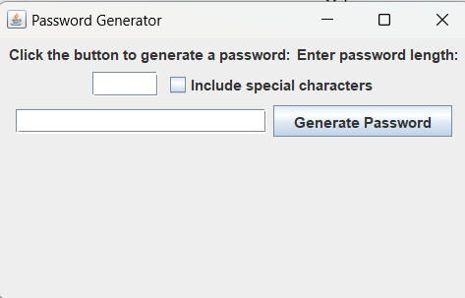
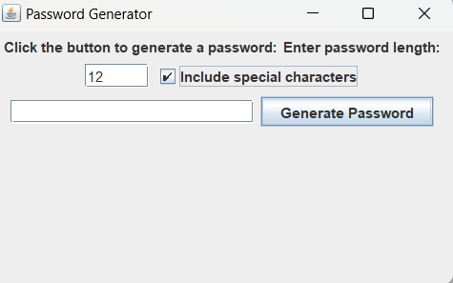
RESULTS AND DISCUSSION

Slide 13
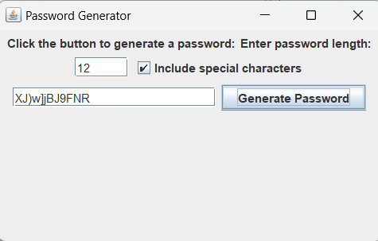
RESULTS AND DISCUSSION

Slide 14
QUERIES ?

